Slide 1



DUVAL COUNTY TDC UPDATE
August 9, 2018

Slide 2
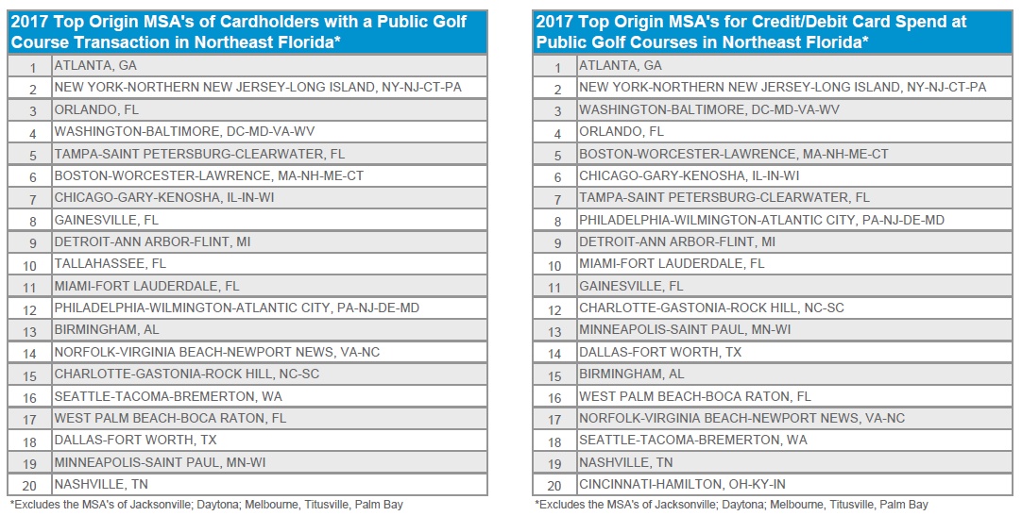
2017 VISA VUE TOP 10 ORIGIN MSA’S
For the NE Florida Golf Visitor

Slide 3













FY 19 ADVERTISING & MARKETING
BROCHURE | AGENCY- $13,815
CONSUMER SHOWS - $24,000
DIGTAL MARKETING - $242,414.75
PRINT MEDIA - $58,196.75
PROMOTIONS- $12,500

Slide 4


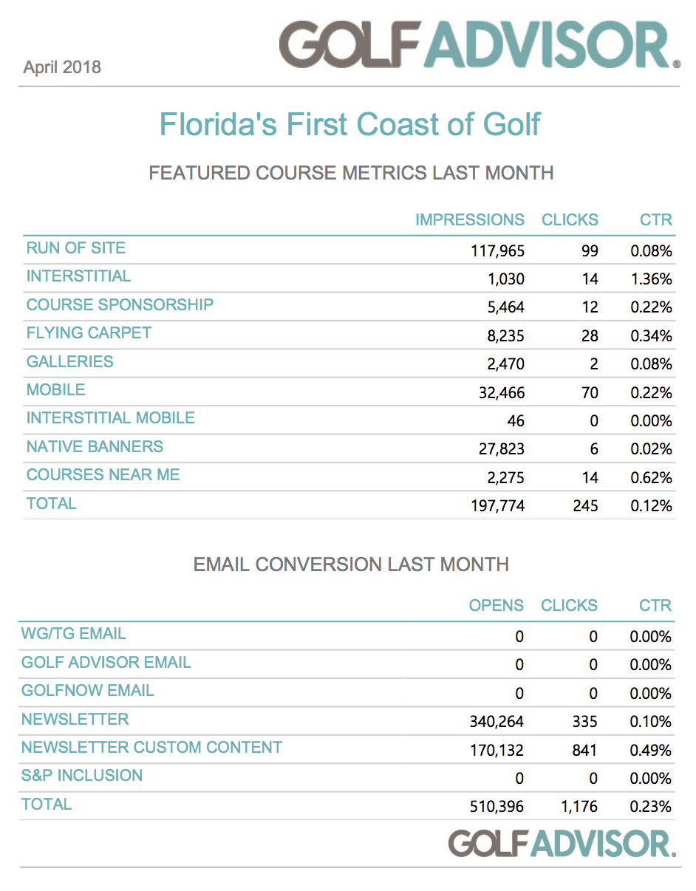
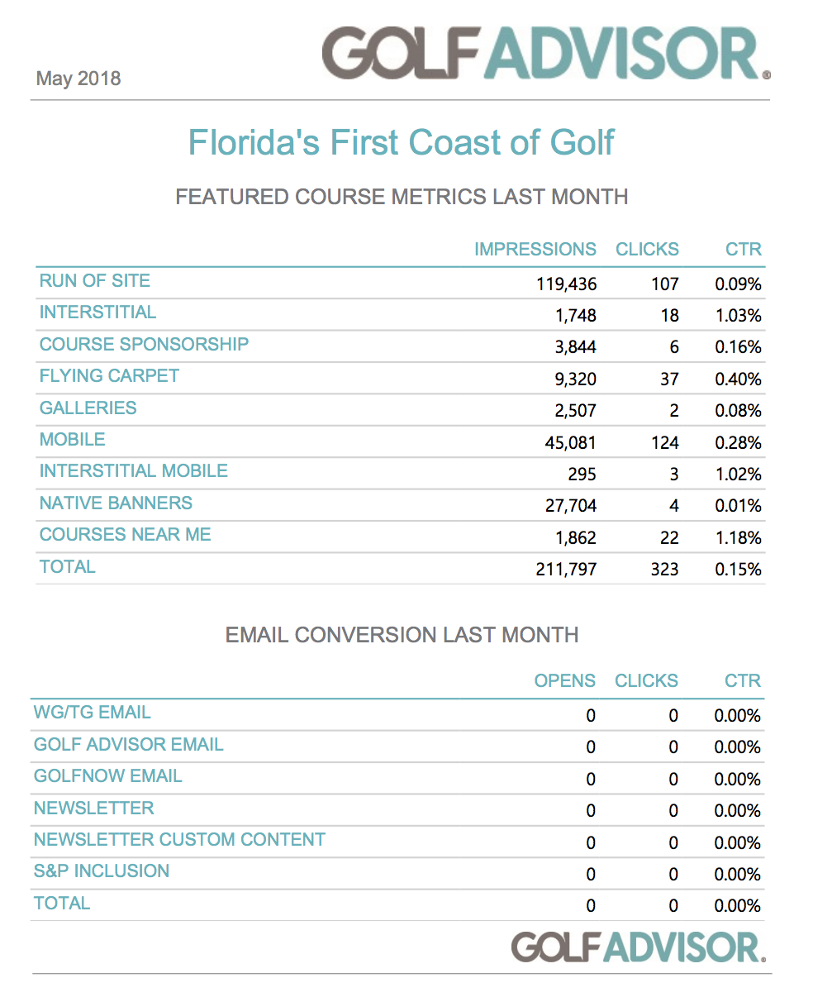
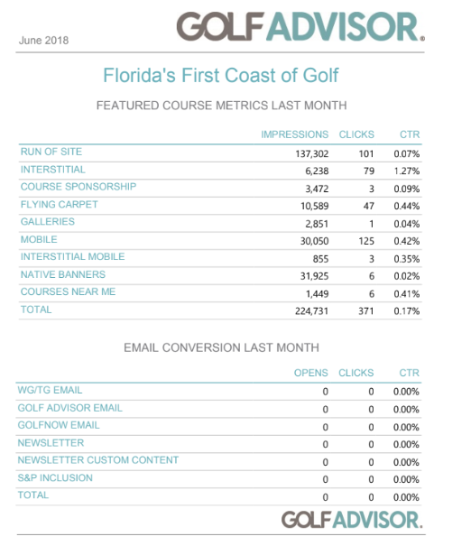
GOLF ADVISOR CAMPAIGN

Slide 5
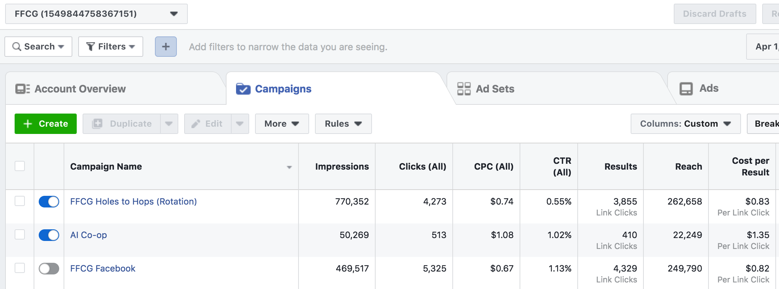
FACEBOOK CAMPAIGN

Slide 6
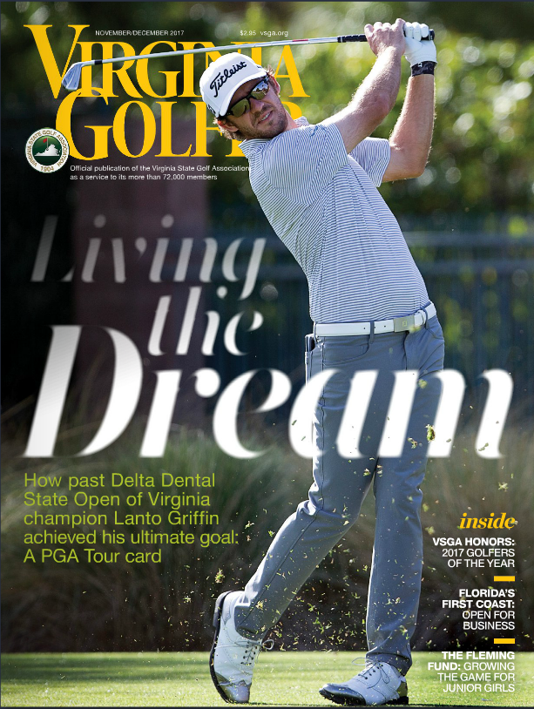

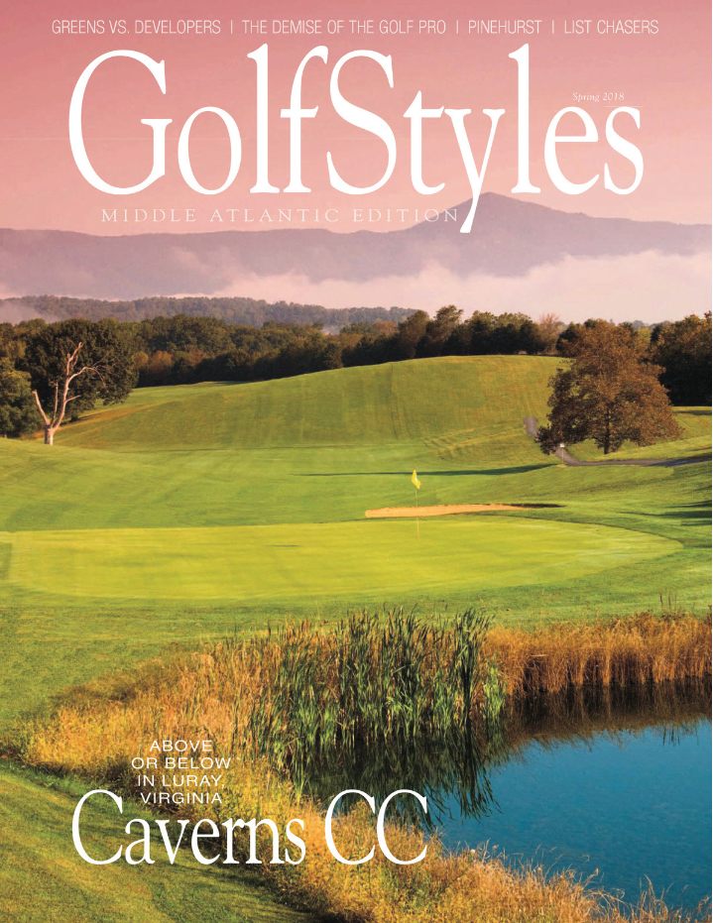
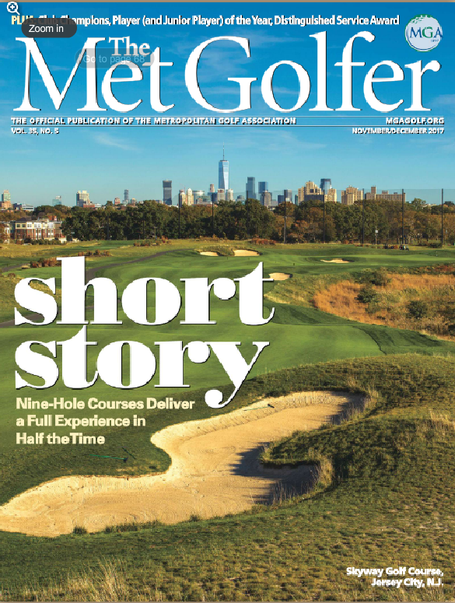
PRINT CAMPAIGNS

Slide 7

GOLFSTYLES

Slide 8

FY 18 PROMOTION & EARNED MEDIA
TELEVISION
CONSUMER SHOWS
PROMOTIONS
PRINT
DIGITAL
TOTAL VALUE: $984,880
IMPRESSIONS: 23,256,751

Slide 9







FY 19 JAGUARS GOLF PROMOTIONS

Slide 10

FY 18 PLAYERS PROMOTION RECAP

Slide 11



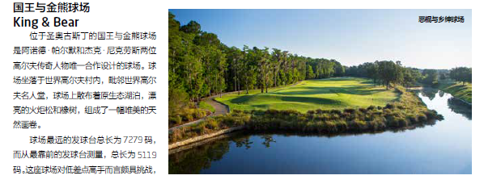
GLOBAL UPDATES
Golf Magazine China
MEDIA FAM December 2017
Katherine Chang, Editor
March 2018 Article
8 Pages Circ: 500K
UPCOMING PLAYERS in ay Issue

Slide 12
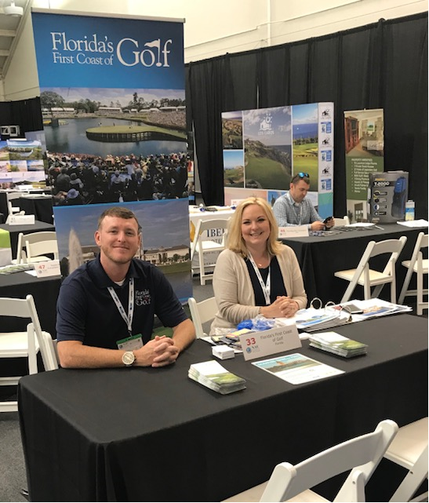

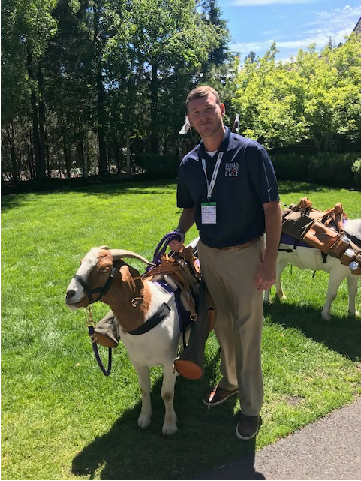


TRADESHOWS
NAC Bend, Oregon
June 24-27, 2018
*UPCOMING*
IGTM Slovenia
October 15-18, 2018
WTM London
November 5-7, 2018

Slide 13
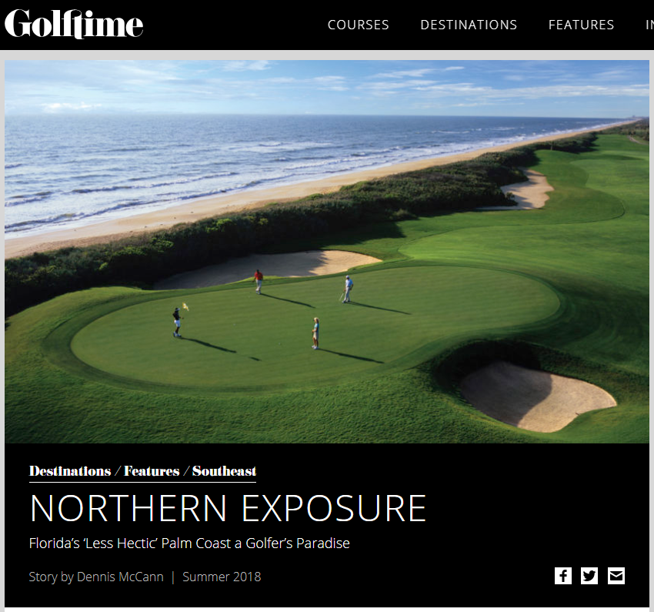
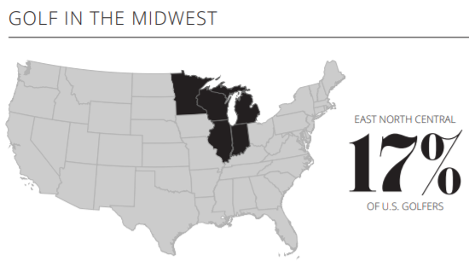
MEDIA FAMS
GolfTime MIDWEST
GOLFTIME MAGAZINE (2x yearly distribution)
Print: 50K
Readership: 120K
Digital: 11K
Dennis McCann, Writer
March, 2018 Visit
Digitally Published July 2018
*FALL Print Date Value: $1,835*
https://www.golftimemag.com/destinations/northern-exposure/

Slide 14
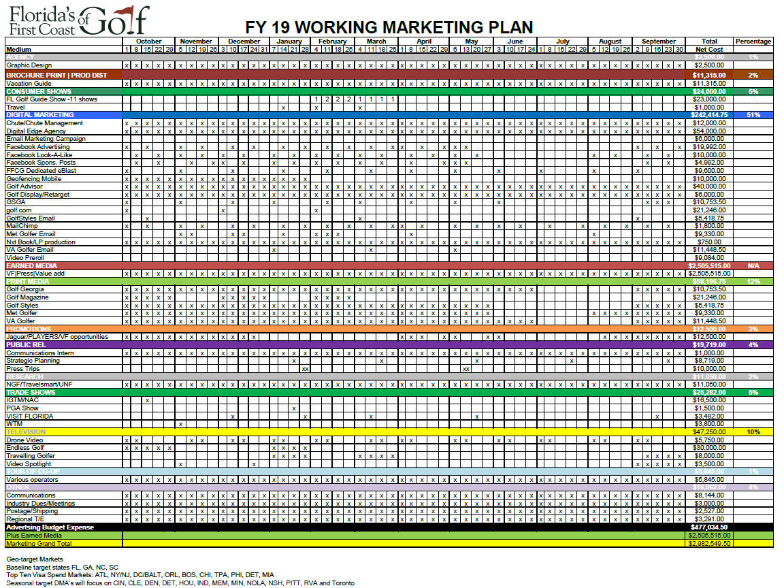
FY 19 MARKETING PLAN

